Slide 1


STEREO Support & Unstructured Grid Development
Community Coordinated Modeling Center
Patrick Zhou
University of Maryland, College Park
Science and Engineering Student Internship

Slide 2


Presentation Overview
CCMC – What It Does, Why We Need Its
STEREO support
  Background
  My role in the project
Unstructured Grid Development
  Background
  Role
Summary

Slide 3
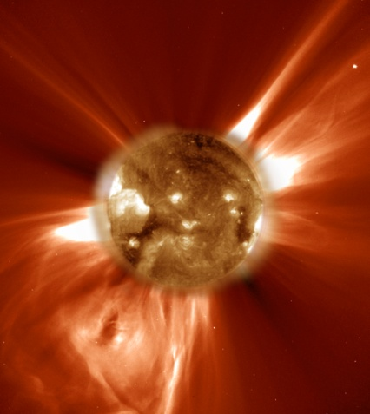
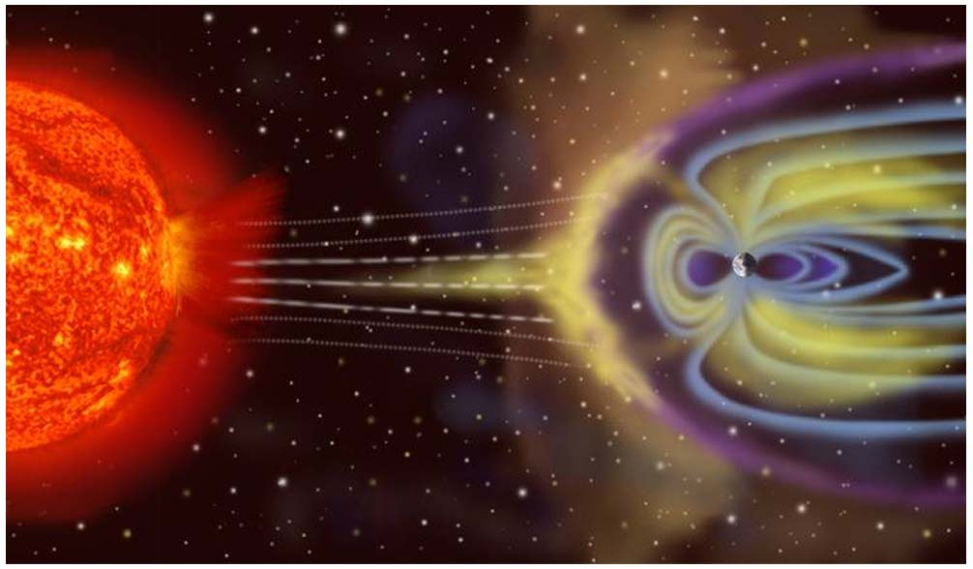
What is the CCMC? Why is it needed?
The Sun is the source of all space weather
  Solar flares and Coronal Mass Ejections (CME) pose a threat to power grids
  Satellite failures (Reduced Lifetime)
  Communications and GPS blackouts
  Particle hazardous to astronauts and polar flight passengers
The Community Coordinated Modeling Center (CCMC) is a multi-agency partnership that:
  Provides modern space research models to the scientific community
  Tests and evaluate models
  Supports Space Weather forecasters and science missions
    STEREO Mission

Slide 4
STEREO Support
STEREO (Solar TErrestrial Relations Observatory) uses two space observatories to study the Sun and coronal mass ejections.
CCMC supports the STEREO project by providing solar and heliospheric models and saves model input and output on a daily basis.
  Archive on CCMC website dedicated to STEREO support
  Data dating back to beginning of 2006
  Goal:
    Create a consistent and accurate archive of solar and heliospheric models for STEREO use
  Problem:
    Model output inconsistent with missing dates and duplicate images

Slide 5
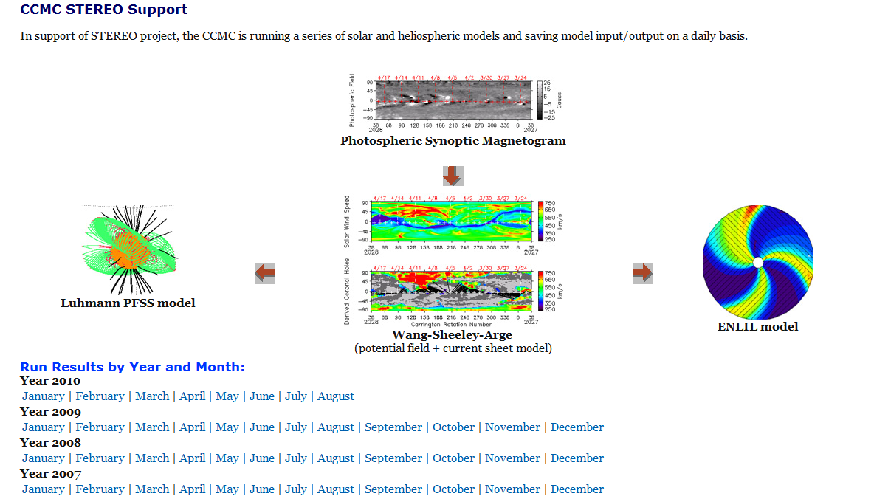
STEREO Support

Slide 6
STEREO Support
Script Process:
Script written in Bash to wrap around model runs.
WSA/PFSS/ENLIL model modified from real time runs to user requested runs
Requested dates are daily runs and outputs
Each daily run takes approximately 15 minutes
Ran through 3+ years of daily input runs from 2007 to 2010.
65% of previous daily archives replaced and updated.
Obtain requested dates from user inputted data file
Download data file from observatory servers
Run WSA/PFSS/ENLIL model
Archive Output Images

Slide 7

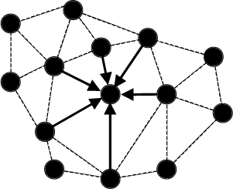
Unstructured Grid
The CCMC currently runs all its models on structured grids.
  Index in memory ( i, j, k)
  Easy to find coordinates
Will receive a model that runs on a unstructured grid
CCMC needs additional software support and routines to work with unstructured grid
  More effort to find a given point
  Performance Issues
What is an unstructured grid?
  Unstructured grids deal use tetrahedral or triangular shapes/elements to discretize the model equations.
Notes:
Breaks the data structure of rectangular grid if you want refinement of the grids, becomes more difficult.

Slide 8
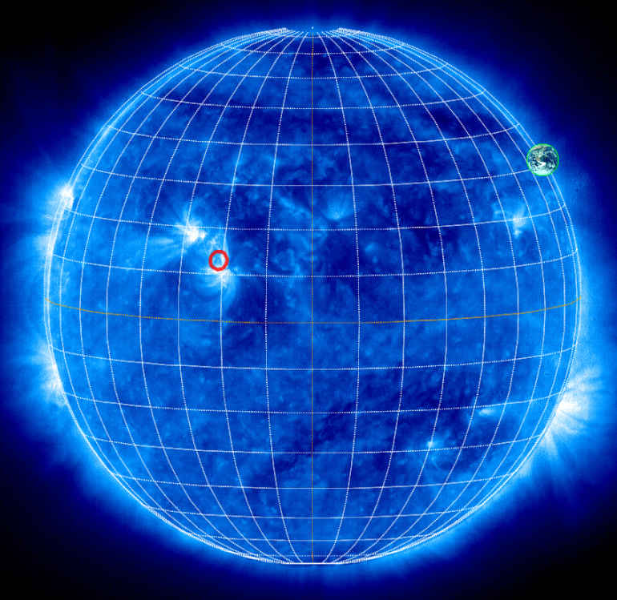
Unstructured Grid
What are the advantages of using an unstructured grid?
  Development of models runs on complex shapes such as spheres (Sun, Earth)
  Difficult to wrap around spherical shape using rectangular coordinates (jagged edges)
    Causes limitations in the zones in which the model can be used, such as the polar regions, no separation distance, skips information
    Causes the model to be unstable and not as accurate
    Using an unstructured grid overcomes these issues.
Notes:
Breaks the data structure of rectangular grid if you want refinement of the grids, becomes more difficult.

Slide 9
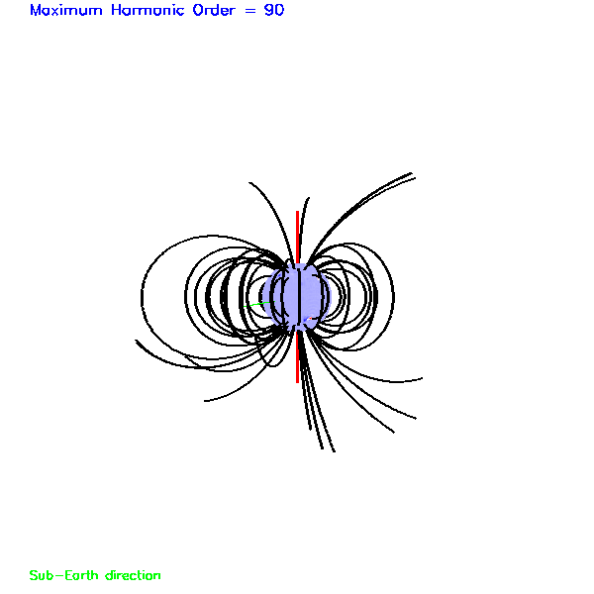
Unstructured Grid
Assisted mentor in creating performance tools for programs that performed a search for points on unstructured grids.
Found that original method was not as fast or efficient as expected.
Began writing a more “smart search function” to overcome the problems of the previous method.
Translated Fortran code into C code for “smart search function” for future use.
Test Case
50 field line
20,000 points along field lines
Had to search along a grid of 4 million elements
Rendered in .35 seconds
Notes:
Ccmc has tools with models, most models have structured grids, process of developing a model that uses tetrahedrals because its easier to wrap around a sphere. Lots of things ccmc deals with are spheres. Poles have infitinitly small grids, skips over information of the grid and cause flows to be unstable. If u take too large a step, u skip information of grids. Cuts grids short, need more inforation. Allows dealing with more information around the poles. A tetrehedral doesn’t have those problems, better for dealing with complex shapes. Ccmc tools cant use the grid, begin to provide support for the graphics for not only structured grids and unstructured grids. Ccmc has visualization tools to render the data, up to now all of them using structured, soon phasing to unstructred, need new routines that enable you to search for a point in the structure grid.

Slide 10
Summary
Created automated script to repopulate STEREO archive using Bash Shell Scripting.
Successfully ran three years worth of data for GONG observatory and will be updated to CCMC database.
Obtained experience in utilizing Bash shell scripting, Fortran and C programming.
Assisted the CCMC with its service of providing model prediction outputs to the community.

Slide 11
Special Thanks
Mentor – Peter MacNeice
Director of CCMC – Michael Hesse
Rest of the CCMC staff
Cori Quirk
SESI

